Slide 1
Climate Change: Earth Surface Temperature Prediction

Slide 2
Table of contents
01
02
03
04
What is climate change?
Why predicting surface temperature important
Datasets used
Project Report

Slide 3
01
What is
climate change?

Slide 4
At the beginning…
Although planet Earth has undergone several changes in its history, the era with the most changes began with the appearance of human beings. Human beings are the ones who have brought a great global imbalance caused by wars, revolutions, irresponsibility in the use of resources, contamination, etc.
All these factors have generated very serious environmental problems, one of them being global warming, which leads to climate change

Slide 5
Climate change
Climate change, according to the United Nations, is the long-term changes in temperatures and weather patterns in the Earth
When there is an alteration of the Earth‘s temperature, it will damage ecosystems and human beings
Unfortunately, it is happening at a very fast pace, so it is necessary to learn more about this issue and act

Slide 6
What are the main causes of
climate change?
There are many causes of climate change:
Natural
causes
Human
causes
Greenhouse effect
For example, large solar temperature variation (extreme heat or extreme cold for several weeks)
Actions that directly harm the planet. An example of this is the extraction of oil
One of the main causes is the greenhouse effect， that gases such as carbon dioxide trap heat in the atmosphere.

Slide 7
How does climate change affect
human beings?
Climate change generates several problems that not only affect the ecosystem, but also human beings. In places affected by intense rains, floods destroy crops, leaving people without food for months at a time
Or, conversely, because of droughts caused by climate change. These cause people to starve due to the loss of their crops. In addition, gas and water pollution also affect foodstuffs

Slide 8
02
Why predicting surface temperature important

Slide 9
Predicting Earth Surface Temperature
Climate change insights
Model validation and development
Comprehensive impact analysis
Understanding and predicting global temperature trends are pivotal for assessing past climate changes, ongoing transformations, and future shifts.
Climate models have been rigorously tested and improved over decades. Their ability to forecast global warming impacts with considerable accuracy enhances trust in their current projections and supports the development of even more refined models​
By predicting temperature fluctuations, scientists can also forecast related phenomena like sea-level rise, extreme weather events, and biodiversity shifts. This holistic view is necessary for creating robust adaptation and mitigation strategies
Reference: NASA’s Goddard Institute for Space Studies

Slide 10
03
Dataset used

Slide 11
Project Datasets
I used the dataset from a compilation put together by the Berkeley Earth, which is affiliated with Lawrence Berkeley National Lab.
Notes:
The Berkeley Earth Surface Temperature Study combines 1.6 billion temperature reports from 16 pre-existing archives. The datasets contained temperature data from 1750 to 2015 on the monthly basis. Meanwhile, I also added the missing data from 2015 to nowadays to validate my predictions and better perfect the datasets.

Slide 12
In the dataset, there are several files:
The main file I am going to use is the global land and ocean temperatures (GlobalTemperatures.csv)
Date: starts in 1750 for average land temperature and 1850 for max and min land temperatures and global ocean and land temperatures
LandAverageTemperature: global average land temperature in celsius
LandAverageTemperatureUncertainty: the 95% confidence interval around the average
LandMaxTemperature: global average maximum land temperature in celsius
LandMaxTemperatureUncertainty: the 95% confidence interval around the maximum land temperature
LandMinTemperature: global average minimum land temperature in celsius
LandMinTemperatureUncertainty: the 95% confidence interval around the minimum land temperature
LandAndOceanAverageTemperature: global average land and ocean temperature in celsius
LandAndOceanAverageTemperatureUncertainty: the 95% confidence interval around the global average land and ocean temperature
Apart from this dataset, I also used GlobalLandTemperaturesByCountry.csv and GlobalLandTemperaturesByCity.csv.
Notes:
The following bullet points are the ids and category names for my main dataset.

Slide 13
04
Project Reports and Analysis

Slide 14
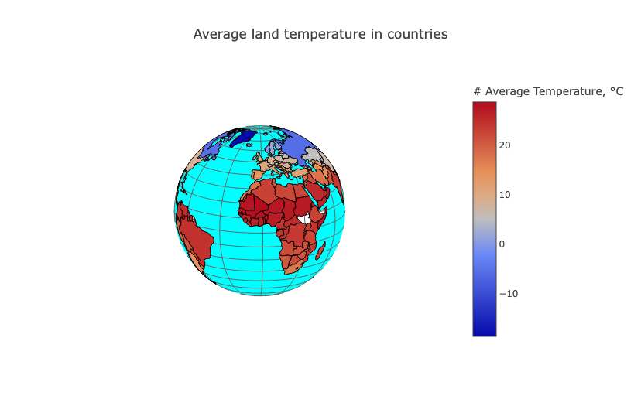
After implementing the necessary packages for Jupyter Notebook, I did an exploratory data analysis on the dataset global land and temperatures by country.
The following graph is an interaction graph that summarize the data in the datasets in the representation of earth. From the graph, we could see the temperature difference in different continents and countries on the earth.

Slide 15
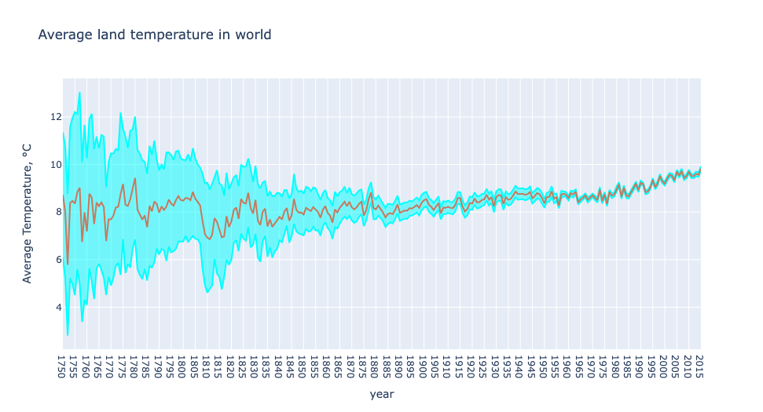
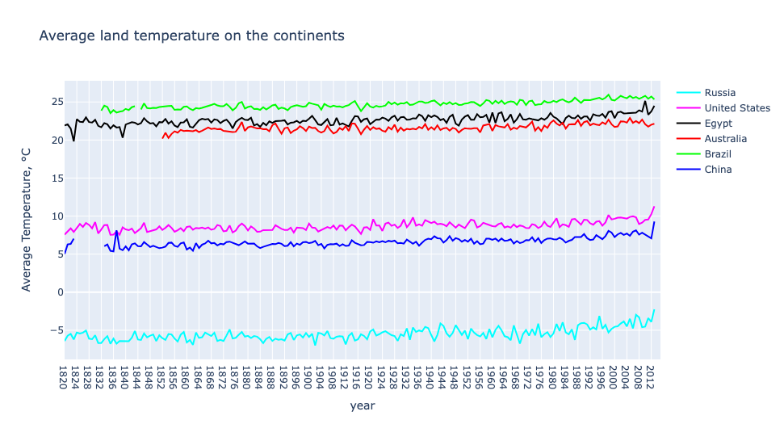
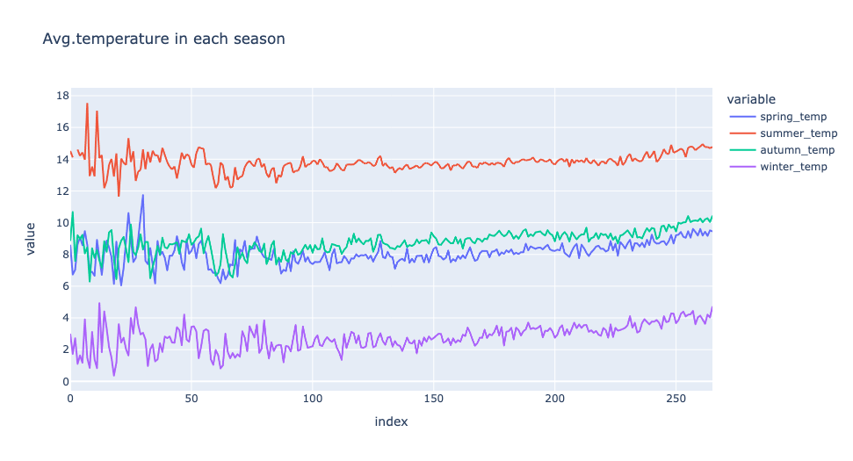
Meanwhile, I also did similar EDA on other datasets to see the trends and characteristics of these datasets. The following graphs are the results of the EDA analysis.
Notes:
The first one is the analysis on the average land temperature in the world
The second one is the analysis on the average land temperature on the continents, among them, Russia has the lowest average temperature whereas Brazil has the highest average temperature
The third one is about the average temperature in each season and we can see that there are a lot overlap during spring and autumn.

Slide 16
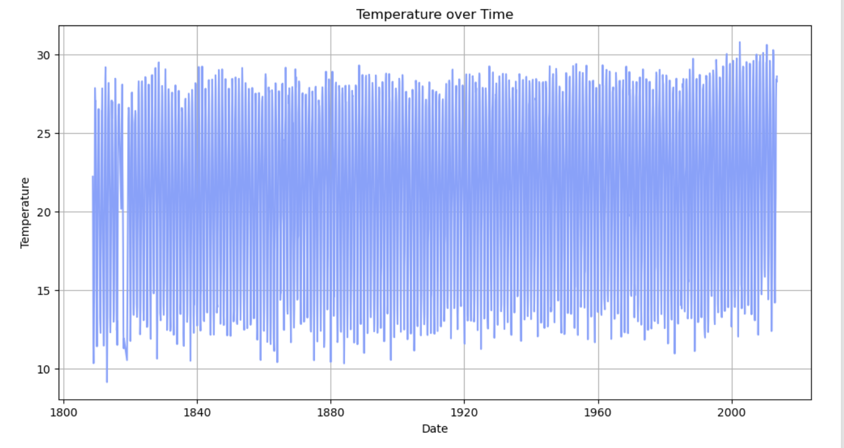
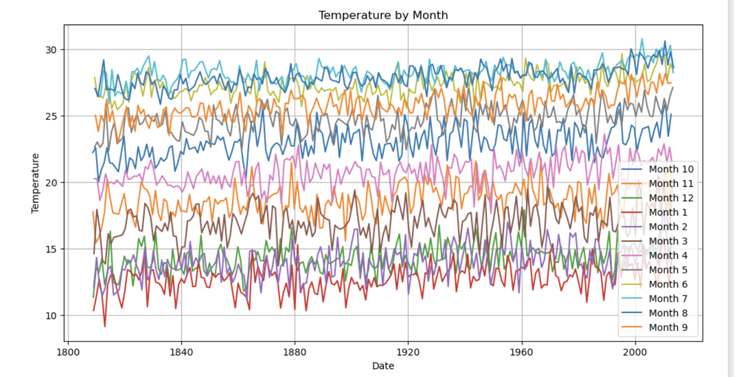
This is two additional graphs that supports my previous statements. The first one is about the temperature over time from 1800 to 2015. The second is about the temperature by month from 1800 to 2015.
Notes:
We could see that after comparing the lowest and highest points from 1800 and 2015, the average temperature increased substantially about 5 degrees.
This aligns with the previous graph that during month 6, 7, and 8 have the highest temperature because it’s in the summer, whereas month 11, 12 and 1 have the lowest because it’s in the winter.

Slide 17
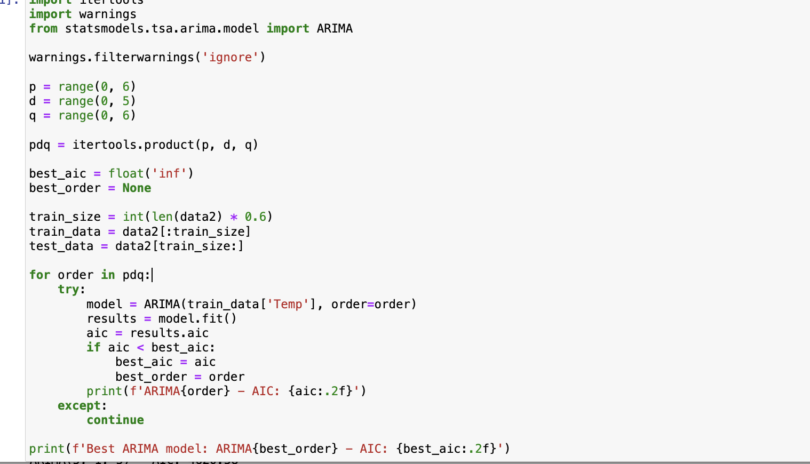
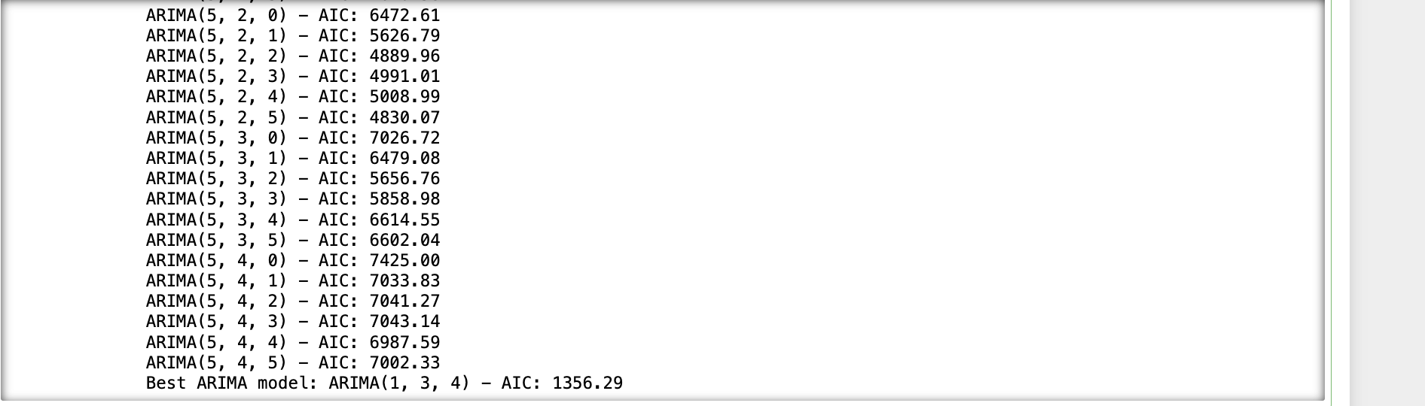
Then, I fitted an ARIMA (Auto Regressive Integrated Moving Average) model to a time series data set to identify the optimal parameters for the model based on the AIC.
The result after several iterations.
Notes:
After the setup of necessary tools, I set up the parameters like p, d and q for the ARIMA model, representing the order of the autoregressive part, the degree of differencing and the order of the moving average part.
Then, I split the times series into training and testing data, with 60% of the data used for training.
Then, we continued to model fitting and selection. If the AIC of a current model is lower than the best (lowest) AIC found so far, this model's parameters and AIC are stored as the best.

Slide 18
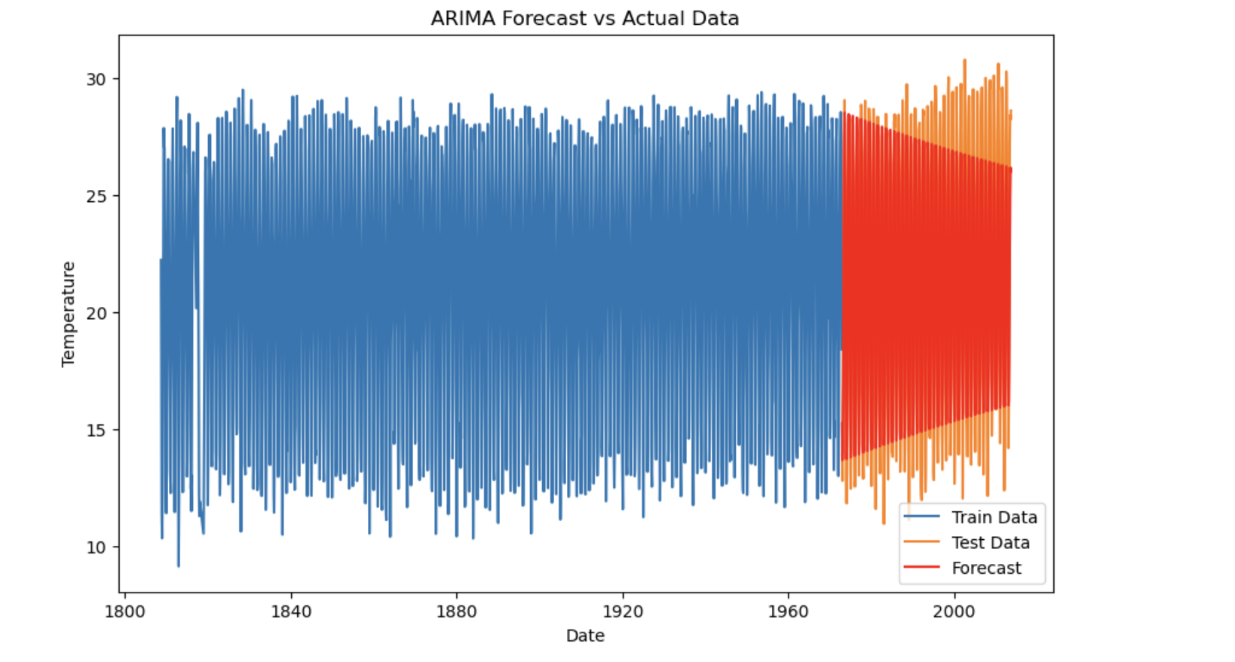
After we fit ARIMA model to testing data, we can output this graph, which is a time series plot comparing the actual temperature data with forecasts from the ARIMA model.
Blue: training data
Orange: test data
Red: forecasted data produced by ARIMA
Notes:
for the blue part, this represents the historical temperature data that was used to train the ARIMA model.
The orange part represents the test data that was used to evaluate the model’s predictive performance.
The red part is the forecasted data generated by the ARIMA model based on the patterns learned from the training data.
If we compare the forecast and actual part, the closer they are, the better the model is at making prediction.

Slide 19
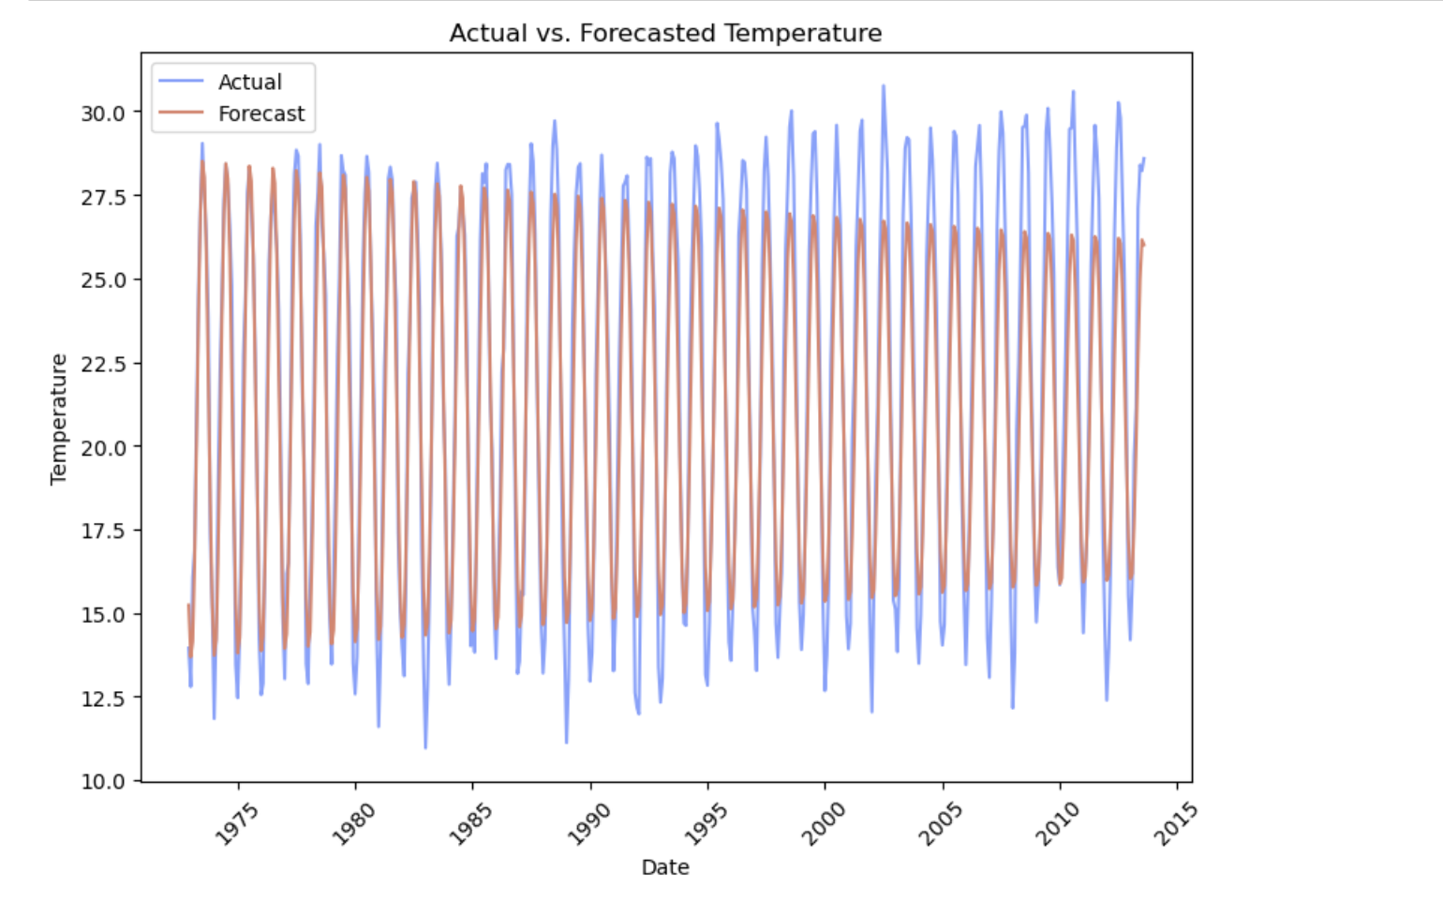
Time series comparison between actual and forecasted temperature data
Notes:
The blue lines represent the actual recorded temperatures over time. The lines show considerable fluctuations, which is typical for temperature data that can change due to seasonal variations.
The red lines represent the forecasted temperatures as predicted by the model. The forecasts follow a similar pattern to the actual temperatures, with similar periodic peaks and troughs.
By overlapping the actual and forecasted data, the graph aims to show how well the forecasting model's predictions align with reality. In an ideal scenario, the red lines would closely overlay the blue lines, indicating high accuracy of the forecast.

Slide 20
Evaluation on the forecasts and model
Model accuracy
Eternal shocks
Forecast horizon
Notes:
When we compare the two graphs of the actual temperature data and the forecasted data, we could see that there are minor discrepancies. There are several reasons for those differences in temperatures
First, it’s the model accuracy. Because the ARIMA models are linear and may have difficulty capture the non-linear patterns and most climate data are non-linear patterns.
Secondly, it could be due to external factors. Some sudden climatic events or policy changes such as the shift to renewable energy nowadays could lead to abrupt changes in temperature trends and the historical model cannot anticipate this change.
Thirdly, it could be due to forecast horizon as the ARIMA models are more accurate for short-term forecasts. As the forecasting horizon extends, the cumulative error can increase, leading to a divergence from actual values.

Slide 21
Thanks!

